Slide 1



Data Analysis Using Power BI Summary
Presentation by:
Thambidurai Sundaramoorthy

Slide 2

Introduction
Domain
Netflix is a global leader in streaming entertainment, offering a vast library of movies, TV shows, and original content. With a presence in over 190 countries, it has transformed the way audiences access and enjoy digital content anytime, anywhere.
Project
To analyze Netflix's content and customer viewing behavior to derive meaningful business insights. The goal is to clean and visualize the data to understand customer engagement, content popularity, and subscription trends.

Slide 3
Objective
Business Use Cases
To identify most popular movies and TV shows based on watch time and ratings.
To analyze customer demographics to understand target audience preferences.
To understand the impact of subscription types on watch time and customer engagement.
To explore content ratings and their effect on viewer behavior.
To provide insights on the best time for content release to maximize engagement.
To assist Netflix in refining it’s content strategy based on genre popularity and user ratings.
To compare customer retention and engagement patterns across different countries.

Slide 4
Data Cleaning & Transformation
Data Consistency Check
Consolidated the raw data of Netflix dataset and customer ratings.
Verified the data types of each column and updated it in the standard format.
20000 TV shows/Movies found where as Director names are missing for 5976 TV shows/Movies.
Replaced the missing Director names with “Unknown” and excluded it in the Power BI tasks related to Directors.
Standardized the data formats in the date_added column.
Power BI Dashboard were created using the consolidated dataset.

Slide 5
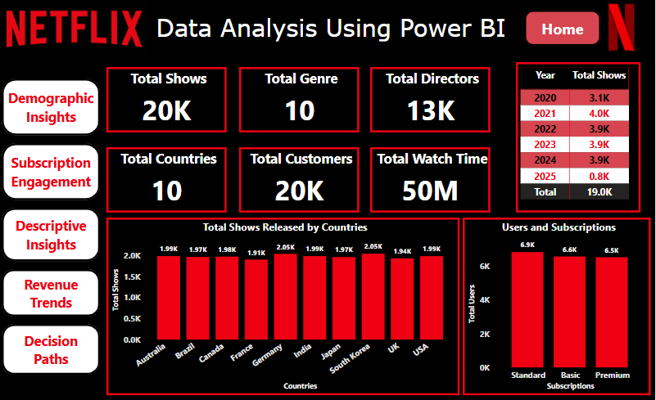
Power BI Dashboard

Slide 6
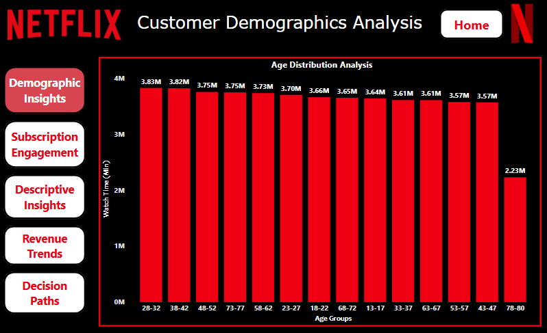
Data Cleaning & Transformation
Customer Demographics Analysis
Customers age has been grouped between 13 to 80 with the set to analyze their distribution.
Age group 28-32 have the maximum watch time of 3.83M followed by the age group 38-42 with 3.82M.
Age group 78-80 have the least watch time of 2.23M.

Slide 7
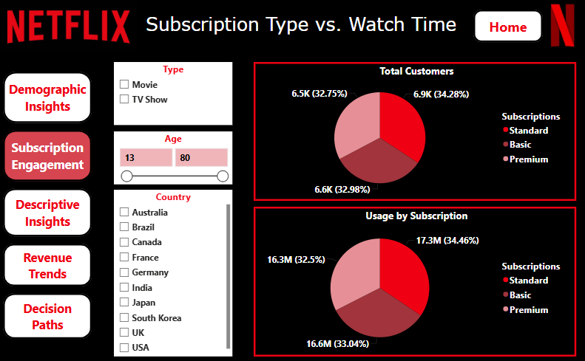
Data Cleaning & Transformation
Subscription Types:
Basic, Standard & Premium
Subscription Type vs. Watch Time
The common relationship between all the subscription types are that all plans have access to all TV shows/Movies available in the platform.
The cost, Video quality, supported devices, simultaneous streaming and download limitation differs between the plans.
Standard type has the maximum users of 6.9K and the highest watch time of 17.3M.

Slide 8
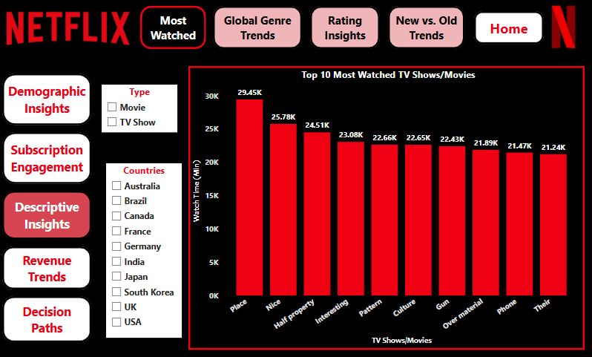
Descriptive & Comparative Analysis
Top 10 Most Watched Shows/Movies
Place is one of the TV show/Movie that has the maximum watch time of 29.45K.
This includes both TV show and Movie.
For movies, Gun has a maximum watch time of 22.43K.
For TV shows, Half Property has a maximum watch time of 24.51K.
Movies alone have an overall watch time of 25.2M and where as TV shows have an overall watch time of 24.8M.

Slide 9
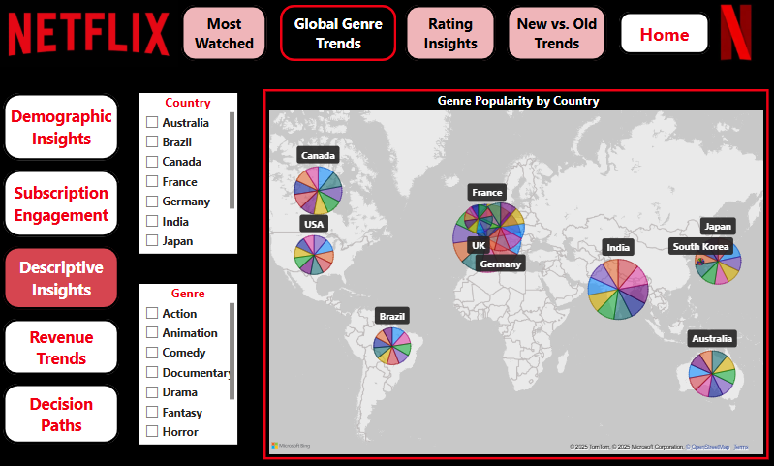
Descriptive & Comparative Analysis
Genre Popularity by Country
Country | Top viewed Genre | Total Viewers
Australia | Sci-Fi | 220
Brazil | Action | 225
Canada | Action | 223
France | Horror | 234
Germany | Documentary | 228
India | Romance | 230
Japan | Romance | 220
South Korea | Action | 215
UK | Thriller | 213
USA | Fantasy | 219
Action genre is being on top for 3 countries followed by Romance for 2 countries which is being the most popular genre across multiple countries.

Slide 10
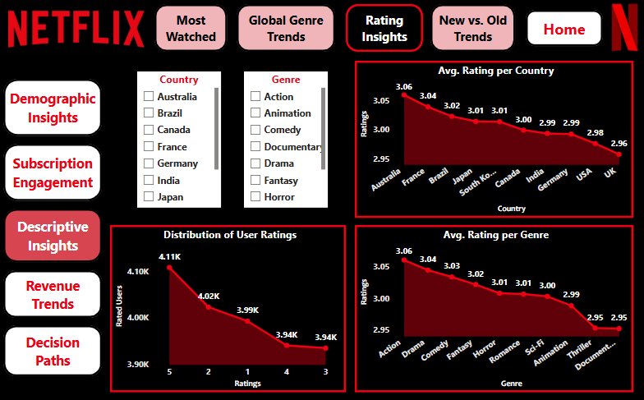
Descriptive & Comparative Analysis
Customer Ratings Distribution
The maximum number of users (4.11K) has provided 5 rating the most where as the least number of users (3.94K) have provided ratings 3 and 4 each respectively.
Australia has the highest average rating of 3.06 where as UK has the least average rating of 2.96.
Action genre received the highest average rating of 3.06 where as Documentary genre received the least average rating of 2.95.

Slide 11
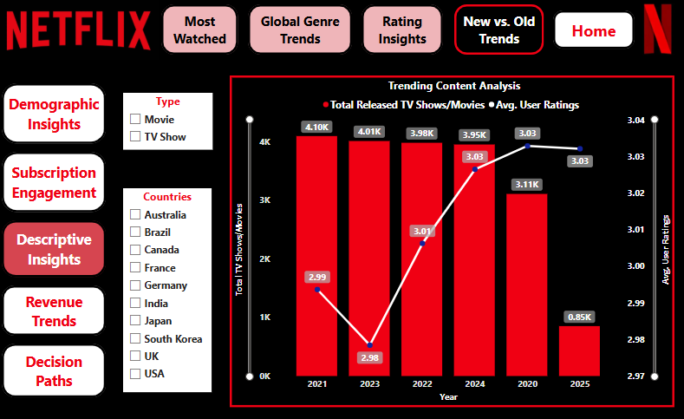
Descriptive & Comparative Analysis
Trending Content Analysis
TV shows/Movie counts are less during the last 2 years (2024 & 2025) compared to the previous years (2020-2023).
An overall TV shows/Movies released in the platform during (2024 & 2025) is 4.80K where as for the year between (2020-2023) is 15.19K.
The average user rating for the year (2024 & 2025) is 3.03 each which is better than the previous years. The newly added content holds the good average user rating.

Slide 12
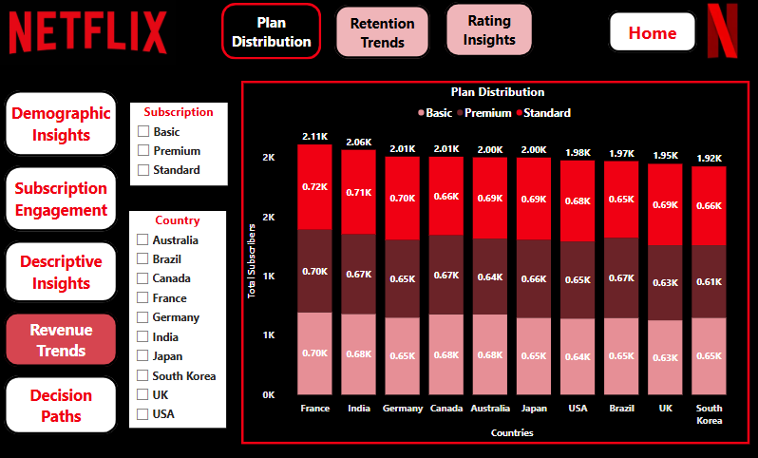
Market Insights & Revenue Analysis
Subscription Market Share Analysis
8 out of 10 countries have the Standard plan subscription with most number of users compared to other subscriptions.
Remaining 2 countries Canada has the most number of users in Basic subscription where as Brazil has the most number of users in Premium plan.
France being on top with most number of users in all the 3 subscription compared to other countries.

Slide 13
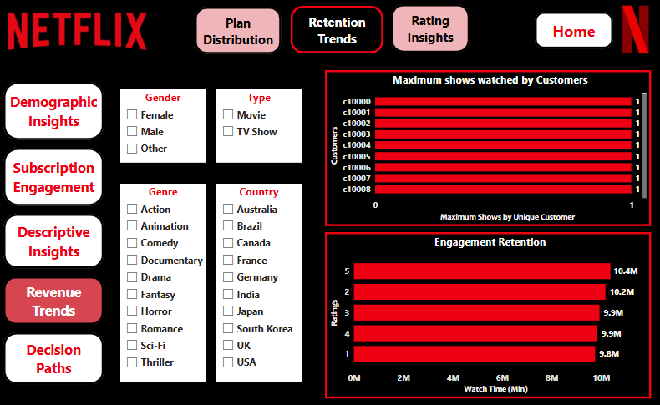
Market Insights & Revenue Analysis
Customer Retention Insights
All the customers have watched only one shows where as no customers watched multiple shows.
The users with maximum watch time of above 10M have rated 2 and 5 ratings for the TV Shows/Movies.
It concludes that high time watchers doesn’t give only high ratings.
All the users provides ratings based on the content engagement.

Slide 14
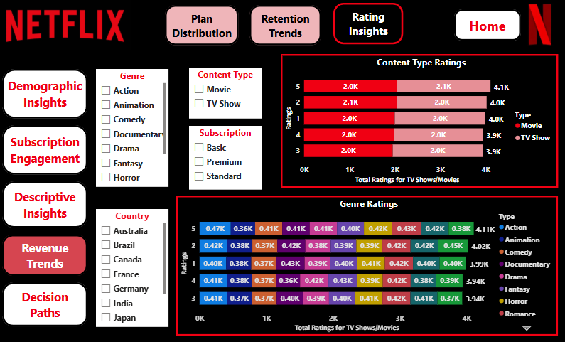
Market Insights & Revenue Analysis
High-Rated vs. Low-Rated Content
Romance genre received the highest number of rating from the users of 2.1K where as Animation genre received the lowest number of rating from the users of 1.8K.
The maximum number of users (468) provided 5 rating for the Action genre where as 427 users provided 1 rating for Documentary genre which is the highest.
TV show holds the highest average rating of 3.01 where as movies holds 3.00.

Slide 15
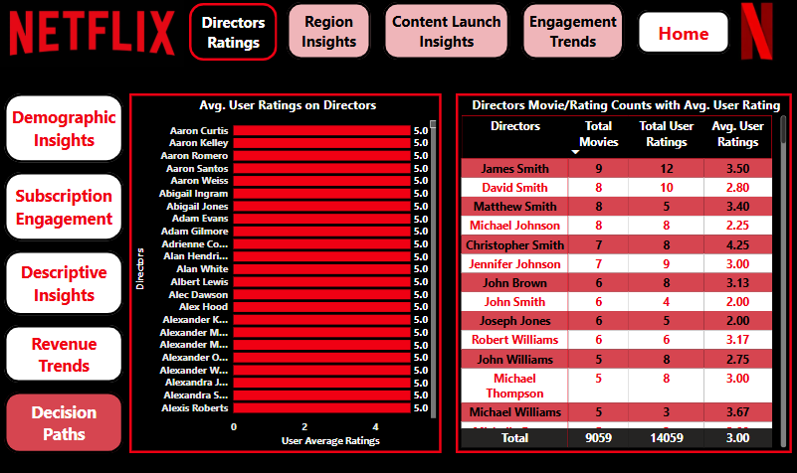
Business Decision-Making Scenarios
Director & Cast Influence on Ratings
Movies directed by well-known or frequently featured directors have higher average user ratings.
Titles featuring popular or frequently cast actors also shown a tendency toward higher user engagement and ratings.
There are more than 5 directors with the average user rating of 5 which the total movies & user rating count of 1 each.
Christopher Smith holds the best average user rating of 4.25 with 7 shows and 8 user ratings.

Slide 16
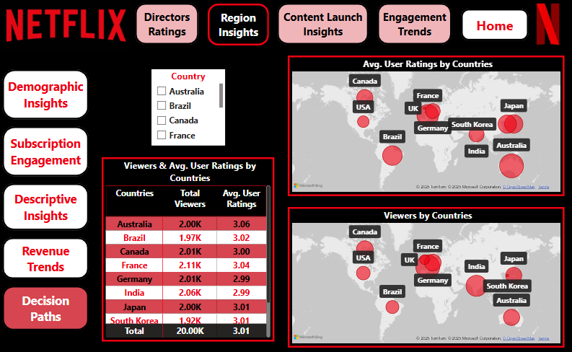
Business Decision-Making Scenarios
Content Localization Strategy
South Korea is underperforming in terms of engagement with 1.92K viewers being the lowest where as USA holds the tag underperforming in terms of average user rating of 2.98 being the lowest.
Expand series in genres like Sci-Fi, Horror, and Romance show higher watch times and engagement.

Slide 17
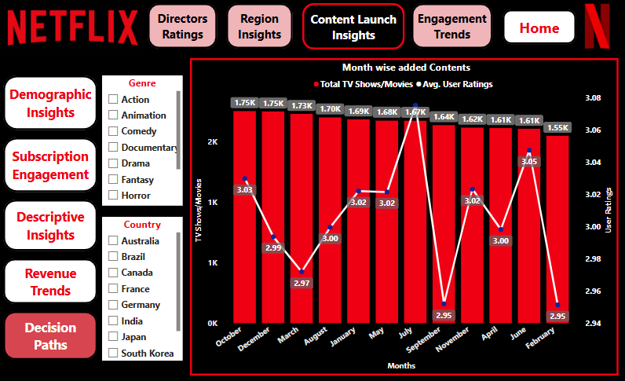
Business Decision-Making Scenarios
Best Time to Release New Content
The maximum number of contents were added during the months October and December which consist of 1.75K each.
The best average user rating of 3.08 was received for the month of July for which 1.67K contents have been added.
The October month is considered as the best release period in terms of most added contents and good average user rating (3.03).

Slide 18
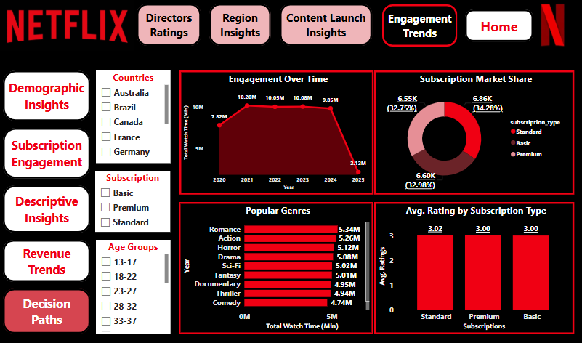
Business Decision-Making Scenarios
Customer Engagement Dashboard
The customer engagement dashboard has been created with multiple chart visualizations and slicers to filter.
Engagement over time has been shown to find the total watch time in each year where as Popular genres has been shown to find the total watch time of each genres.
Subscription market share has been shown to find the number of users using each subscriptions where as Avg. rating for each subscription has been shown.

Slide 19
Business Decision-Making Scenarios
Competitor Benchmarking Simulation
Comparison of content availability by country: South Korea generally has the most diverse content availability, particularly in genres like Action and Sci-Fi. Germany offers high availability in Documentary, Fantasy, and Horror. Canada has a strong presence in Fantasy and Sci-Fi. Brazil and France excel in different genres, particularly with Action, Documentary, and Romance. Australia and USA have a good variety but slightly lower numbers compared to other countries. | Comparison of ratings by country: Australia has the highest rating at 3.06. Brazil, France, and Japan follow closely with ratings above 3.00. Germany, India, and USA have ratings just below 3.00. UK has the lowest rating at 2.96.

Slide 20
Business Decision-Making Scenarios
Content Availability by Movie and TV Show Categories for each Genre
Genre | Movies | TV Shows
Action | South Korea has the highest availability (125), followed by Brazil (123), and Japan (115). Germany has the lowest availability (89). | South Korea leads with 125, followed by Brazil (102) and Germany (122). USA has the lowest availability (96).
Animation | Australia and Canada lead with 108 and 105, respectively. UK has the lowest at 78. | Australia leads with 95, followed by Canada (86) and South Korea (87). UK has the lowest availability (78).
Comedy | USA has the highest availability (107), with Brazil (116) and South Korea (103) close behind. Australia has the lowest availability (91). | Brazil leads with 90, while USA and Germany both have higher availability (96-106). UK has the lowest availability (74).
Documentary | Germany has the highest availability (127), with Canada (97) and Brazil (74) on the lower side. | Germany has the highest availability (128), followed by France (101). USA has the lowest availability (97).
Drama | France has the highest availability (109), while USA has the lowest (79). | India leads with 118, followed by Canada (79) and France (101). South Korea has the lowest availability (74).

Slide 21
Business Decision-Making Scenarios
Content Availability by Movie and TV Show Categories for each Genre
Genre | Movies | TV Shows
Fantasy | Canada has the highest availability (113), while Germany (89) has the lowest. | South Korea leads with 122, followed by Japan (102), while Germany (92) and Canada (99) lag behind.
Horror | France leads with 108, while South Korea (85) and USA (89) have the least. | Germany leads with 109, followed by France (103). USA has the lowest availability (92).
Romance | South Korea (126) leads, followed by USA (100) and Brazil (92). Australia has the lowest availability (87). | India leads with 122, followed by Australia (105). USA has the lowest availability (95).
Sci-Fi | Australia leads with 103, followed by Brazil (94), while South Korea (81) has the least. | France leads with 114, followed by Canada (113) and USA (106). South Korea has the lowest availability (79).
Thriller | Brazil has the highest availability (116), while South Korea (79) has the lowest. | South Korea leads with 115, followed by UK (108) and Canada (110). USA has the lowest availability (95).

Slide 22
Business Decision-Making Scenarios
Strategies to improve User Preference
Focus more on localized contents and invest more in regional productions with authentic local storytelling.
Use interactive Advanced AI-based suggestions beyond watch history — consider mood, time of day, and even social trends.
Promote offline viewing reminders for commuters/travelers.
Introduce viewer badges, streaks, or achievement systems.
Build a Netflix Rewards Program: unlock content previews, offline events, or discounts for being active users.
Provide more control over recommendations and A/B test UI variations — layout, thumbnails, preview timing — based on viewer engagement.
Offer exclusive early access or bonus scenes to premium subscribers or loyal viewers.
Make the subscription plans cost effective.

Slide 23


THANK YOU
Thambidurai Sundaramoorthy
stdurai95@gmail.com

